Slide 1
Functional Requirement
Functional requirement defines a function of a system or its component, where a function is described as a specification of behavior between outputs and inputs.
involve calculations, technical details, data manipulation and processing, and other specific functionality that define what a system is supposed to accomplish.

Slide 2
Functional Requirement
Describe the behavior of system
Support users goals, tasks or activities
Detailed and specified in the system design
It contain unique name and number
Helps to reader to understand why requirement is needed.

Slide 3
Functional Requirement Should Include
Description of data to be entered
Description of operation performed by each screen
Description of work flows performed by the system
Who can enter the data into a system

Slide 4
Non Functional Requirement
How system works?
It make system more tangible
Related the usability of system
Judge the operation of system, rather than specific behaviors

Slide 5
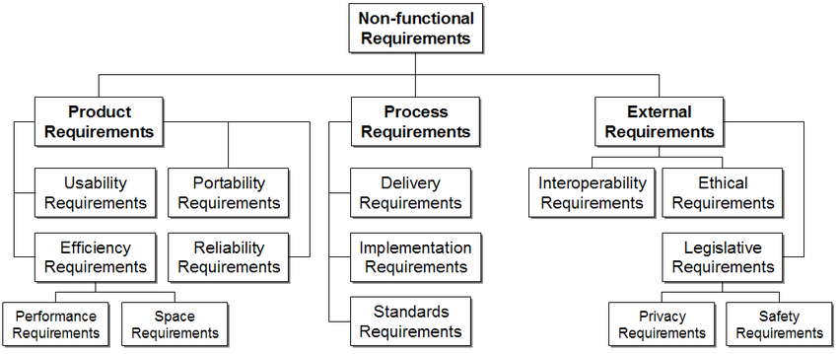

Slide 6
Security
Logging
Storage
Configuration
Performance
Cost
Interoperability
Flexibility
Disaster recovery
Accessibility

Slide 7
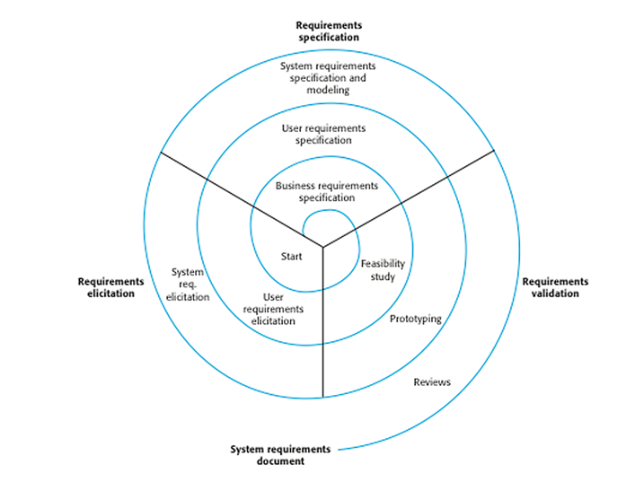

Slide 8
Requirement Specification
Requirement specification is the process of writing down the user and system requirement in a requirement document.

Slide 9
Requirement Engineering Process
Feasibility Study
Requirement Gathering (Elicitation and Analysis)
Software Requirement Specification
Software Requirement Validation

Slide 10
Software Requirement
The software requirements are description of features and functionalities of the target system
Requirements convey the expectations of users from the software product.

Slide 11
Software Requirements Characteristics
Clear
Correct
Consistent
Coherent(Logical)
Comprehensible
Modifiable
Verifiable
Prioritized
Unambiguous (specific)
Traceable
Credible source

Slide 12
User Requirement
User requirement are statements, in a natural language plus diagram, of what services the system is expected to provide system users and the constraints under which it must operate.
It should describe the functional and non functional requirements so that they are understandable by system user who don’t have detailed technical knowledge.

Slide 13
System Requirement
System requirements are more detailed descriptions of the software system’s functions, services and operational constraints.
It adds the details and explain how the user requirement should be provided by the system.
The system requirements document should define exactly what is to be implemented.

Slide 14
Software Requirement Documentation
All the expected functionalities out of the application are documented in terms of “Requirements” and this document is called a Requirement document

Slide 15
